Slide 1
The Project You Asked For ☺
I would like to call it “the uncompleted ticket for my future dreams”.

Slide 2
Who am I? (Self-introduction)

Slide 3
Environment Setup & Configuration
Xampp.
Composer.
Php 5.4 (with artisan).
Laravel 4.2.11.
Gitbash.

Slide 4
PHP CODE

Slide 5
Database (PhpMyAdmin)

Slide 6
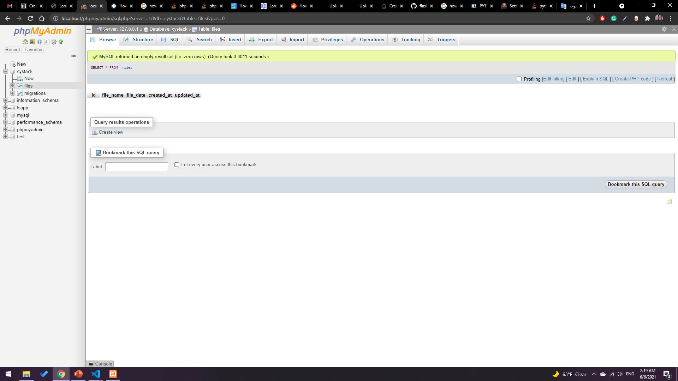

Slide 7
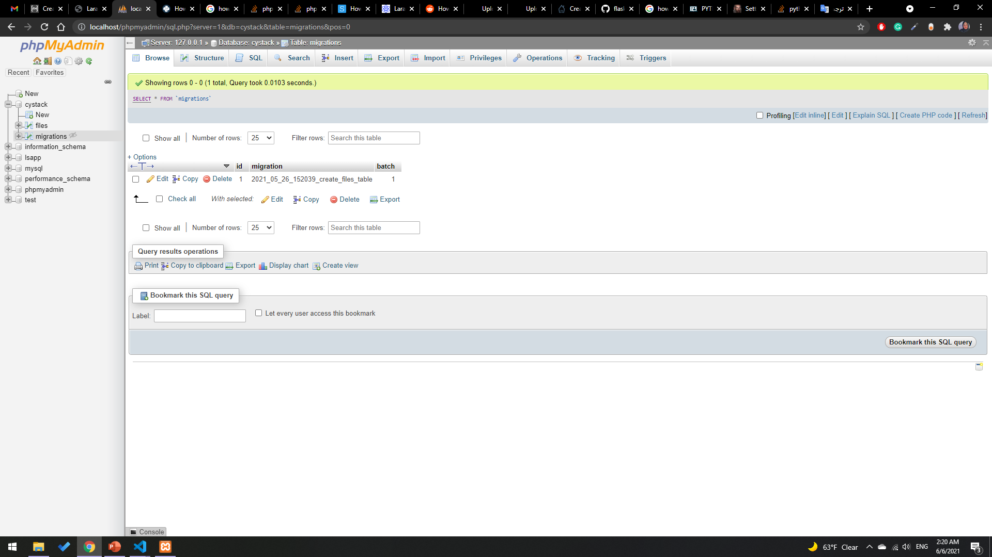

Slide 8
Flask API

Slide 9
Some Screenshots

Slide 10
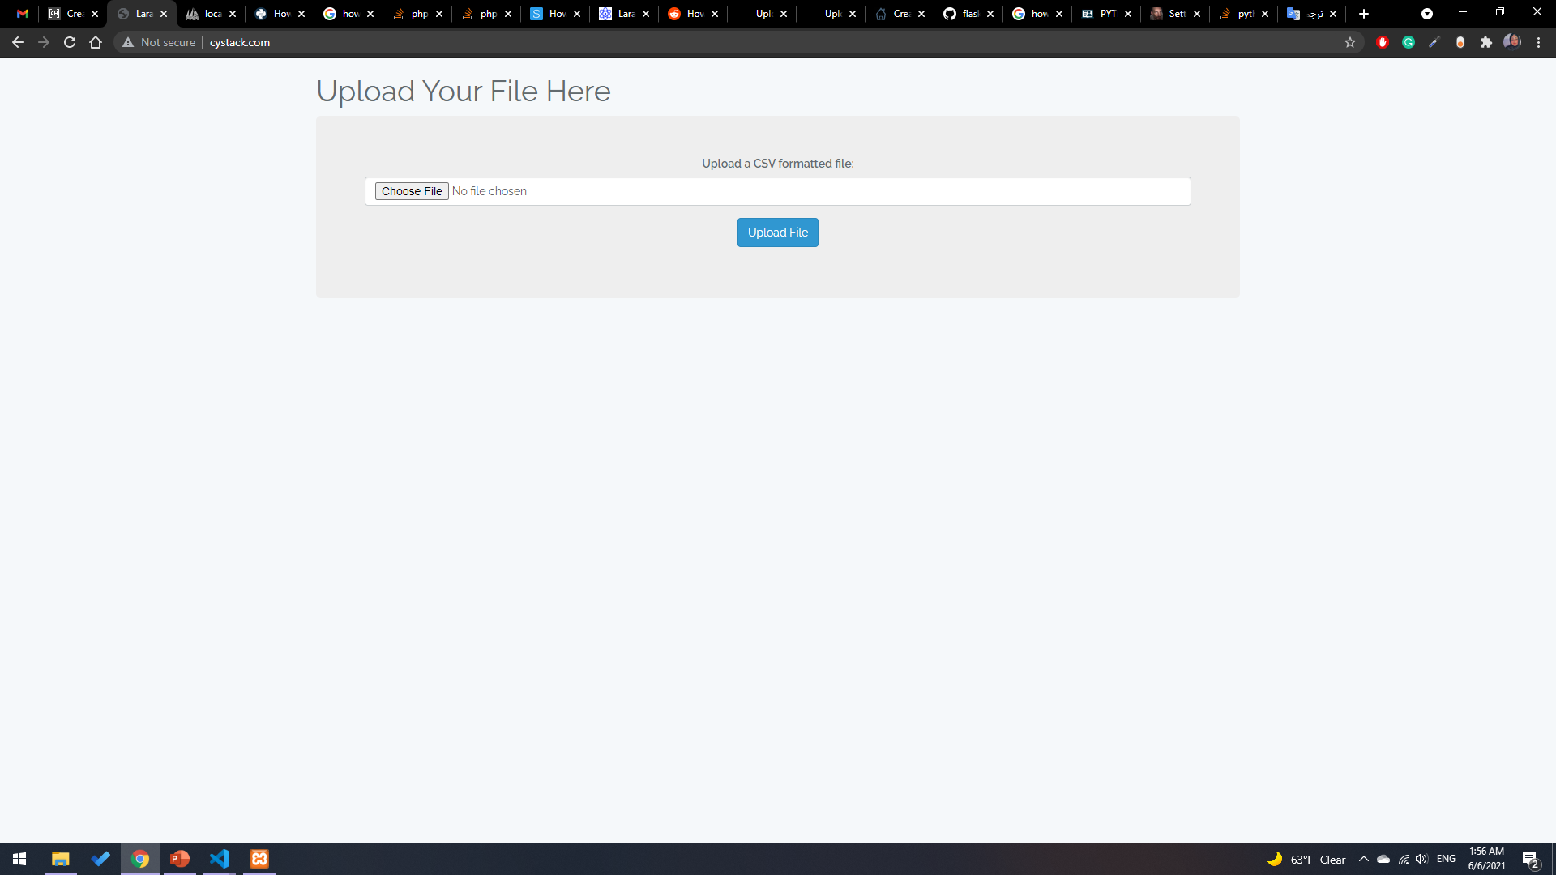

Slide 11
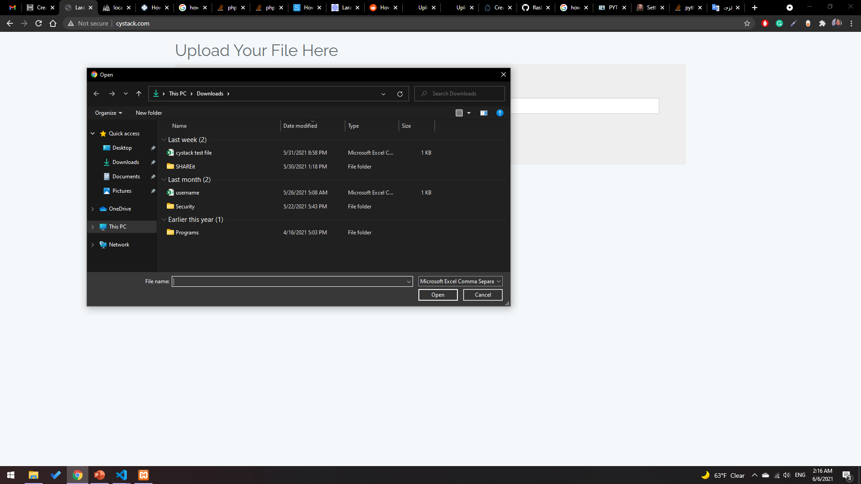

Slide 12
